Slide 1
PROJECTION OF PLANE
08 MARKS
Visit for more Learning Resources

Slide 2
CO’S RELATED THIS CHAPTER
Draw the position of line, planes, solids with reference plane

Slide 3
Plane surface (plane/lamina/plate)
A plane is as two dimensional surface having length and breadth with negligible thickness. They are formed when any three non-collinear points are joined. Planes are bounded by straight/curved lines and may be either regular or an irregular. Regular plane surface are in which all the sides are equal. Irregular plane surface are in which the lengths of the sides are unequal.
Positioning of a Plane surface
A plane surface may be positioned in space with reference to the three principal planes of projection in any of the following positions:
Parallel to one of the principal planes and perpendicular to the other two.
Perpendicular to one of the principal planes and inclined to the other two.
Inclined to all the three principal planes.

Slide 4
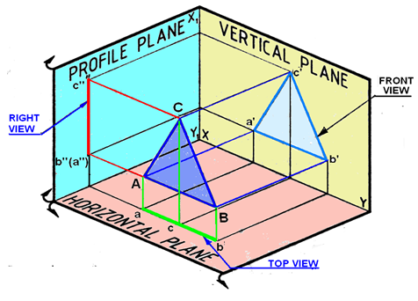
Projections of a Plane surface
A: Plane surface parallel to one plane and perpendicular to the other two
Figure 1. Projections of a triangular lamina on the projection planes

Slide 5
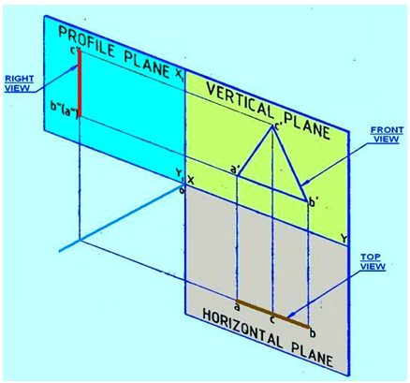
Figure 2. Rotation of PP and HP after projection

Slide 6
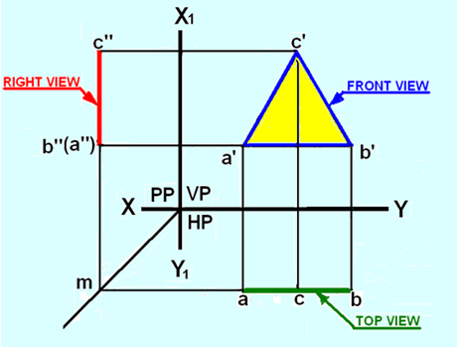
Figure 3. Orthographic projections of the lamina ABC

Slide 7
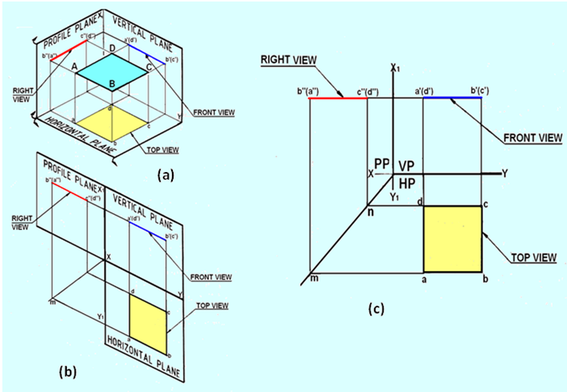
B) Plane parallel to HP and perpendicular to both VP and PP
Figure 4. Projections of the lamina with its surface parallel to HO and perpendicular to both VP and PP

Slide 8
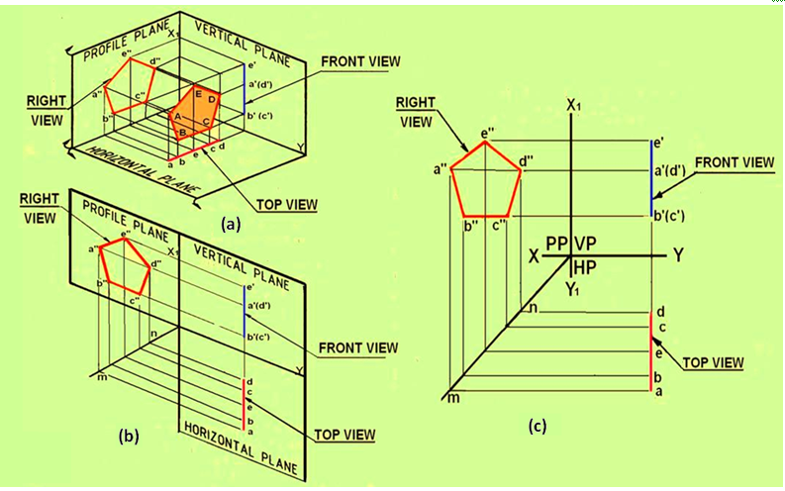
Plane parallel to PP and perpendicular to both HP and VP
Figure 5 Projections of a pentagonal lamina with its surface parallel to PP and perpendicular to HP and VP

Slide 9
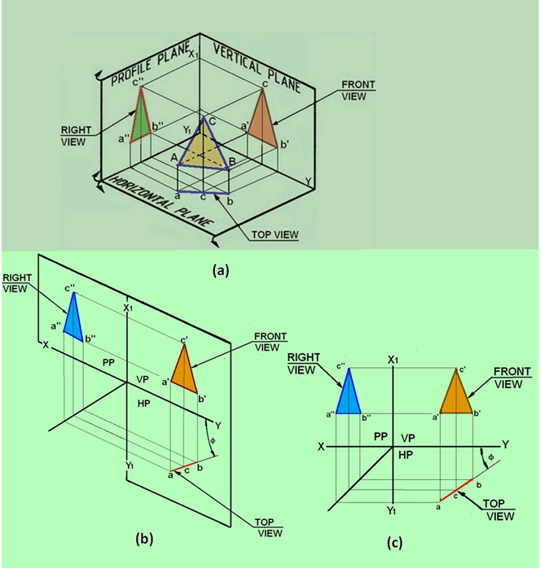
D) Plane surface perpendicular to one plane and inclined to the other two
Figure 6. The projections of the triangular lamina
For more detail contact us

